Slide 1
Capstone Project
Cardiovascular Risk Prediction

Slide 2
Project Flowchart
Introduction
Problem Statement
Data
Methodology
Results
Conclusion

Slide 3
INTRODUCTION
Cardiovascular disease (CVD) refers to a group of disorders that affect the heart and blood vessels, such as coronary artery disease, heart failure, and stroke. It is one of the leading causes of death worldwide, accounting for nearly 18.5 million deaths per year, or 31% of all global deaths. The World Health Organization (WHO) estimates that CVDs will remain the leading cause of death by 2030.
CVDs are caused by a combination of genetic, lifestyle, and environmental factors. Risk factors for CVD include high blood pressure, high cholesterol, smoking, diabetes, obesity, and physical inactivity. The onset of CVD can be prevented or delayed by managing these risk factors through lifestyle changes such as healthy diet, regular exercise, and avoiding tobacco use.
Early detection and diagnosis of CVDs is crucial in order to prevent or delay the onset of serious complications and death. Machine learning has the potential to assist in the prediction of cardiovascular risk, by identifying individuals at high risk of developing CVDs and allowing for earlier interventions. This can lead to improved outcomes and reduced healthcare costs.

Slide 4
Machine learning is a subfield of artificial intelligence (AI) that enables systems to learn from data and make predictions or decisions without being explicitly programmed. It involves the use of algorithms and statistical models to analyze and understand complex data.
There are different types of machine learning, including supervised learning, unsupervised learning and reinforcement learning. In supervised learning, a model is trained on labeled data, meaning that the desired output is already known. This type of learning is used to predict outcomes. In unsupervised learning, the model is trained on unlabeled data, and it is used to identify patterns or features in the data.
Machine learning has the potential to assist in the prediction of cardiovascular risk by analyzing large amounts of data and identifying patterns that are not easily observable by human analysts. This can lead to more accurate predictions of CVD risk and earlier interventions.
For example, supervised machine learning algorithms such as logistic regression, decision tree, and random forest can be used to predict the likelihood of a patient developing CVDs based on risk factors such as age, blood pressure, cholesterol levels, and other health-related information.
In unsupervised machine learning, clustering algorithms such as k-means and hierarchical clustering can be used to identify subgroups of individuals at high risk of CVDs based on their similarity in terms of risk factors and other health-related information.
It's important to note that, while machine learning has the potential to assist in the prediction of cardiovascular risk, it is not a replacement for clinical judgement and should be used in conjunction with other diagnostic tools and techniques.

Slide 5
Problem statement
Coronary heart diseases (CHDs) are the leading cause of death globally, taking an estimated 18.6 million lives each year, which accounts for 33% of all the global deaths.
Therefore It is important to detect cardiovascular diseases as early as possible so that management with counselling and medicines can begin.
Our main aim here is to predict if a patient has a ten year risk of future coronary heart diseases based on a set of metrics.

Slide 6
DATA
The dataset is from an ongoing cardiovascular study.
The dataset provides the patients’ information.
It includes over 33900 records and 15 attributes.
Each attribute(column) is a potential risk factor and these attributes include demographic, behavioral, and medical risk factors.
To increase the efficiency of our analysis we will first have to understand the data and also check if there are some corruptions in the data and if any found we will try to treat it.

Slide 7
We used different libraries which we imported at the start to handle the duplicate and missing values
Also, we dropped “ID ”and “education” column because of their insignificant contribution towards analysis of problem statement
We checked for discrete and continuous variables in our dataset. So that we can perform EDA upon them to get insights

Slide 8
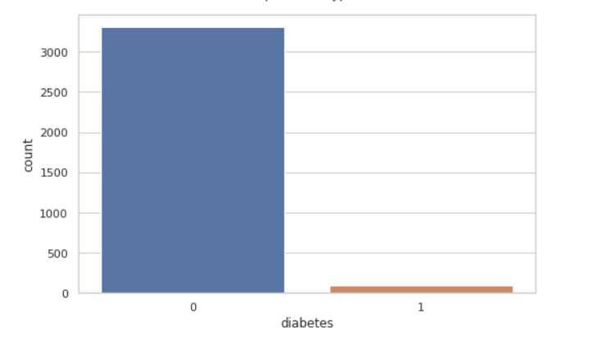
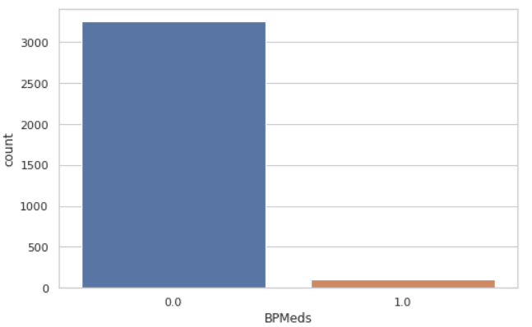
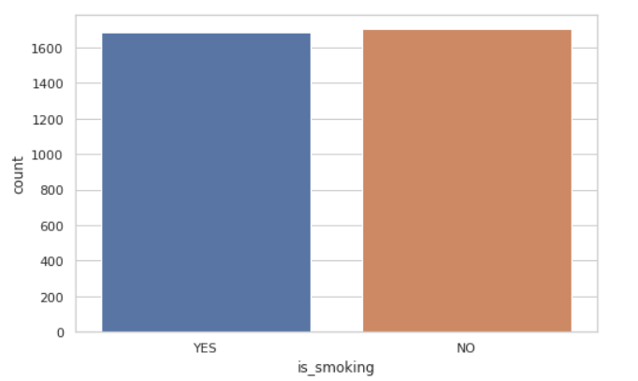
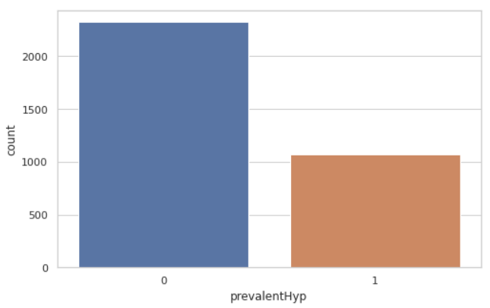
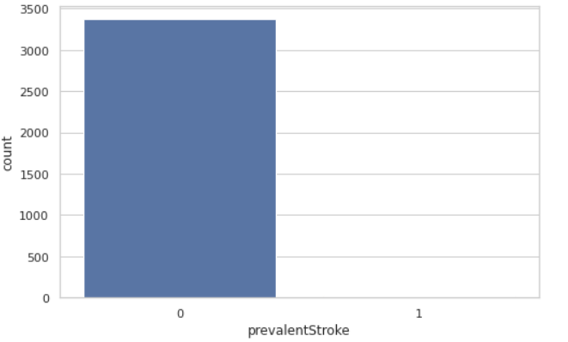
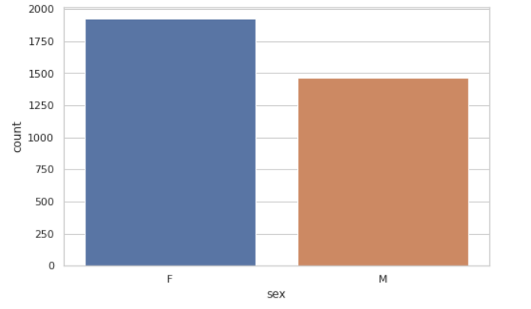
UNIVARIATE ANALYSIS

Slide 9
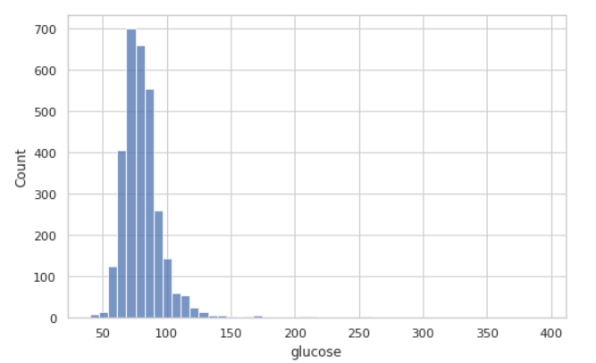
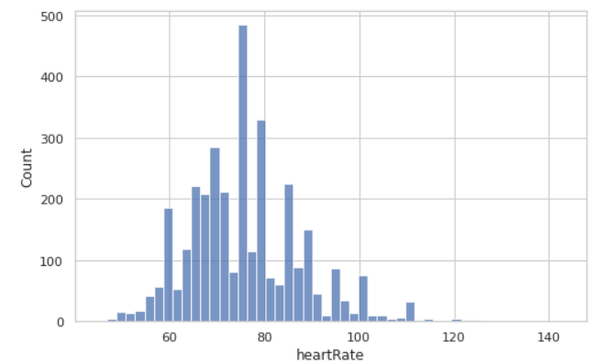
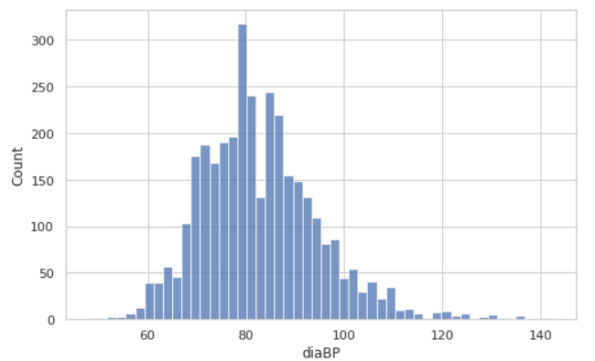
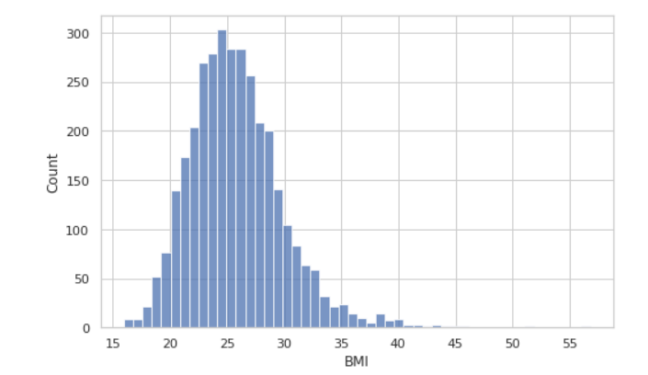
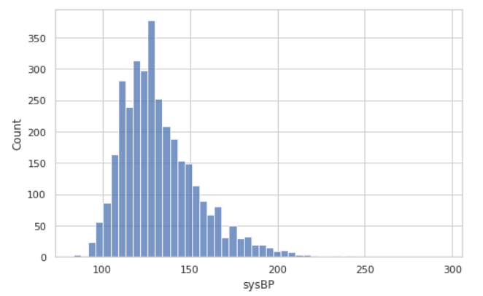
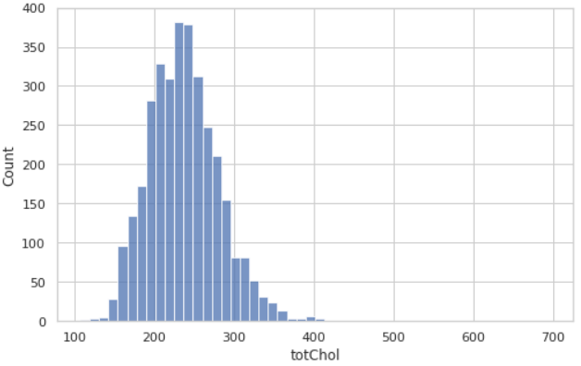

Slide 10
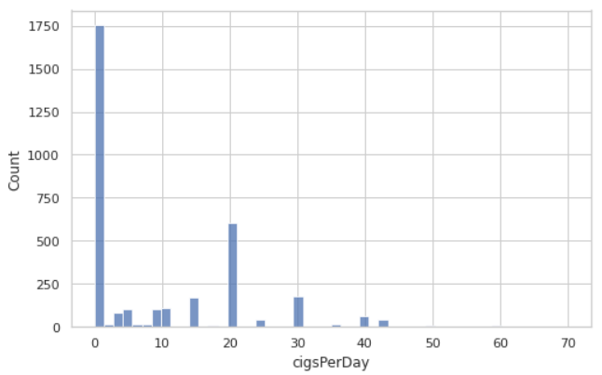
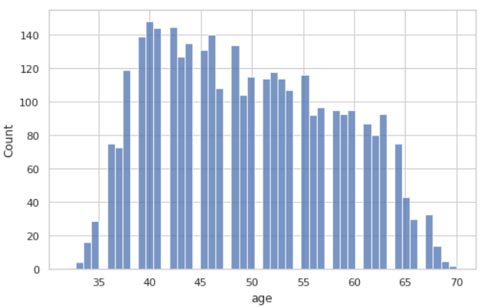

Slide 11
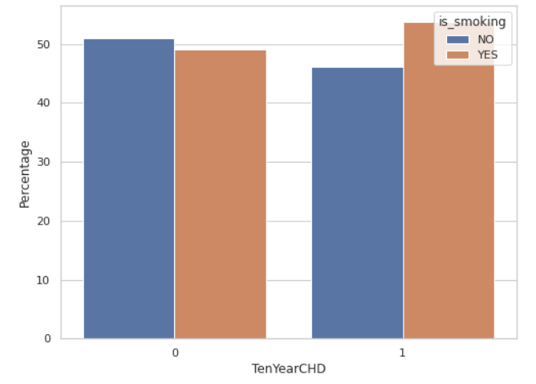
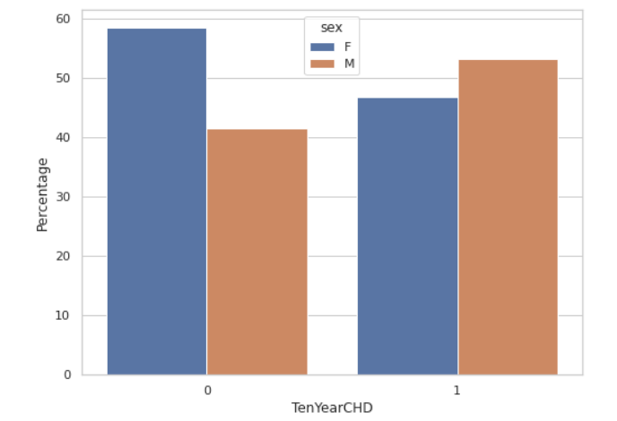
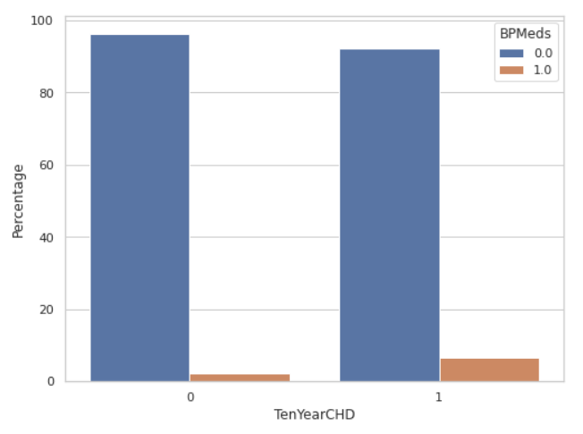
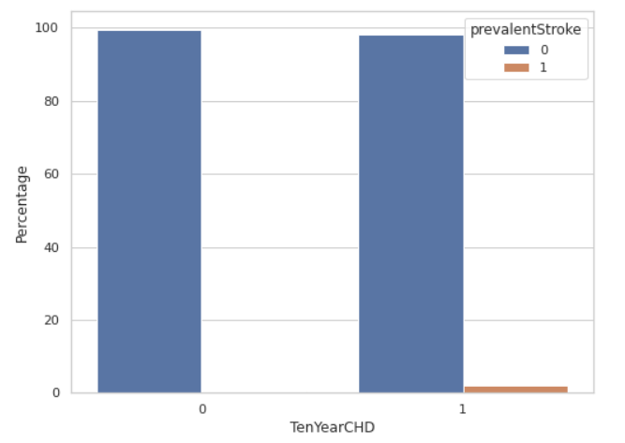
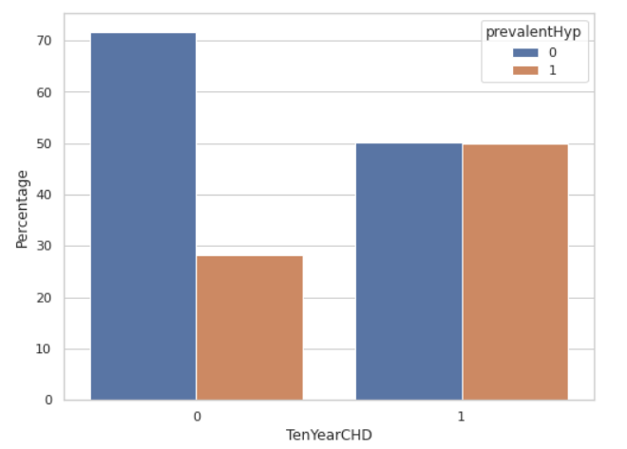
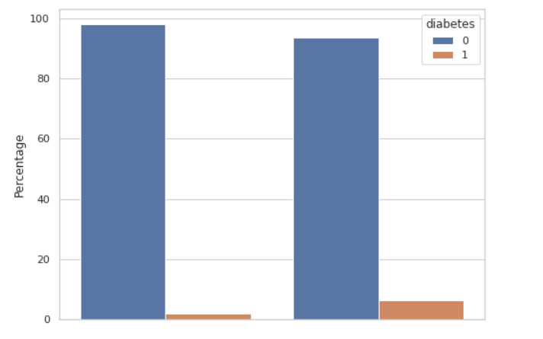
BIVARIATE ANALYSIS
Analyzing the relationship between the dependent variable and the discrete variables in the data

Slide 12
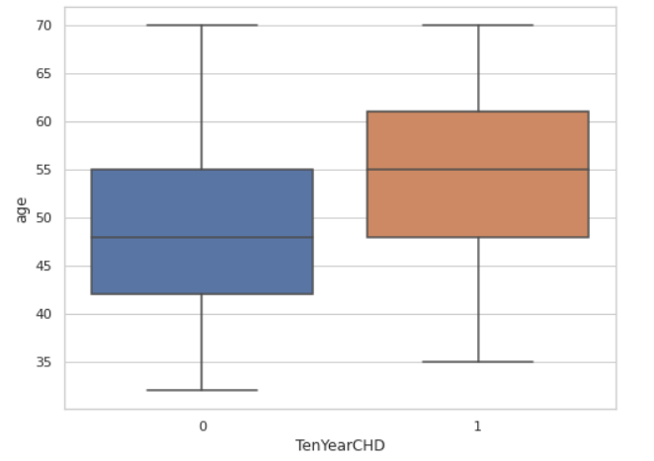
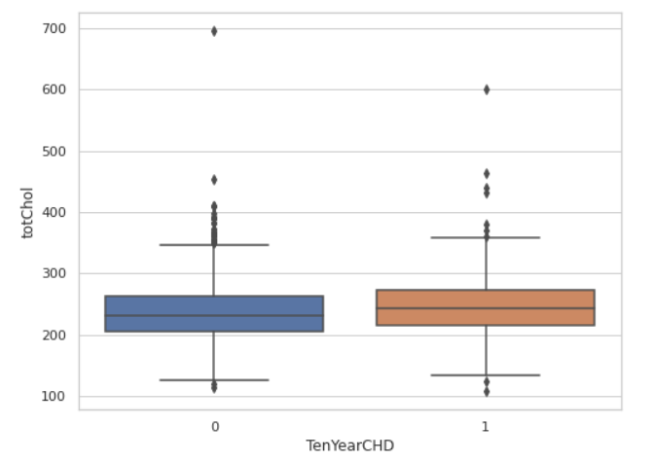
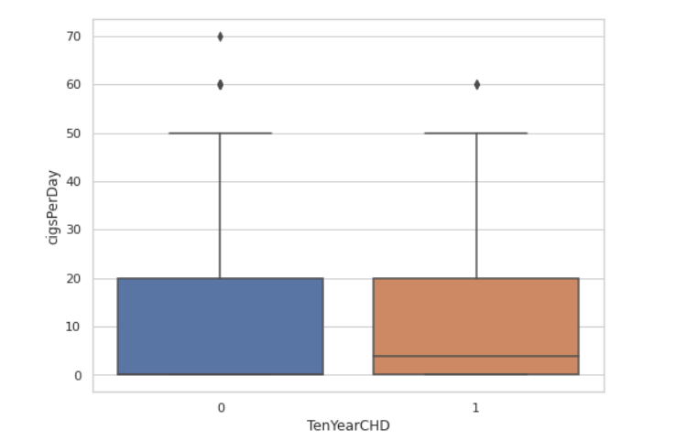
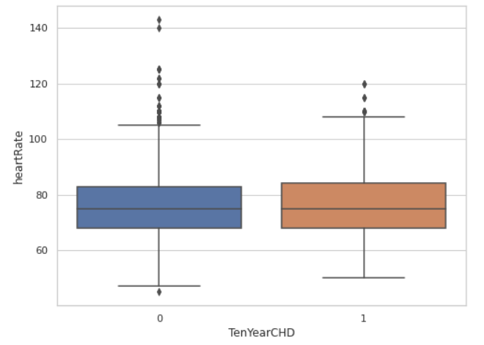
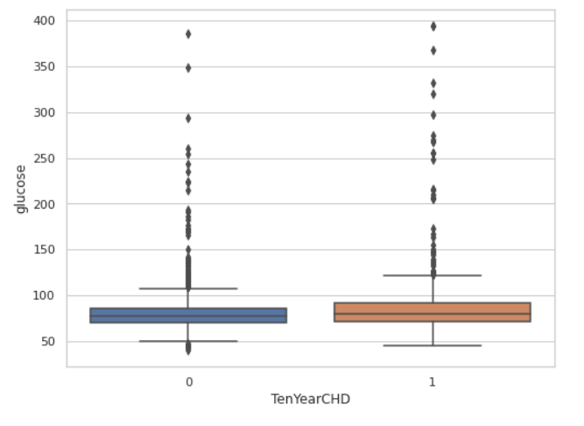
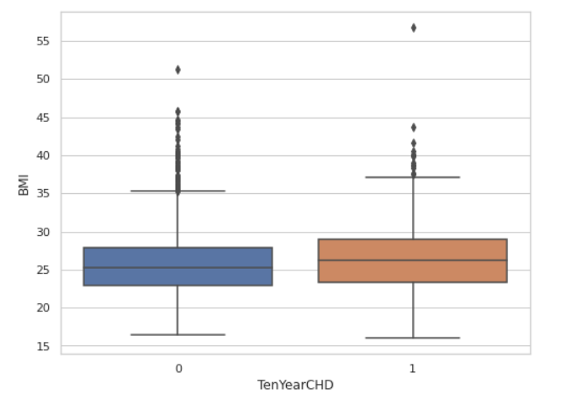
Analyzing the relationship between the dependent variable and the continuous variables in the data

Slide 13
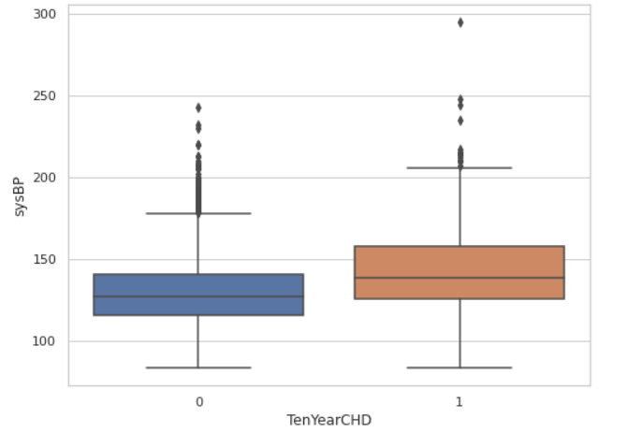
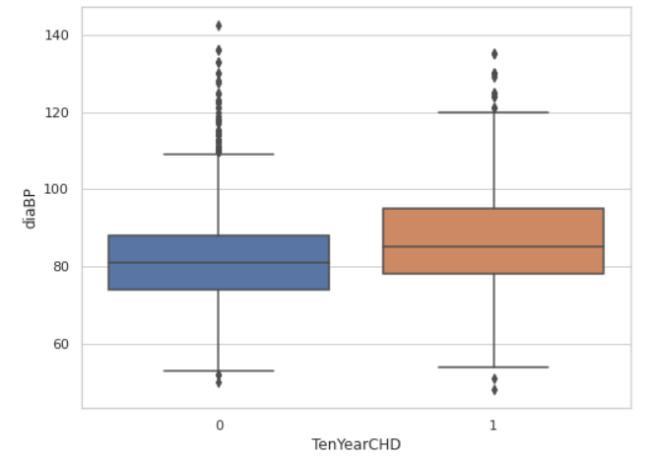

Slide 14
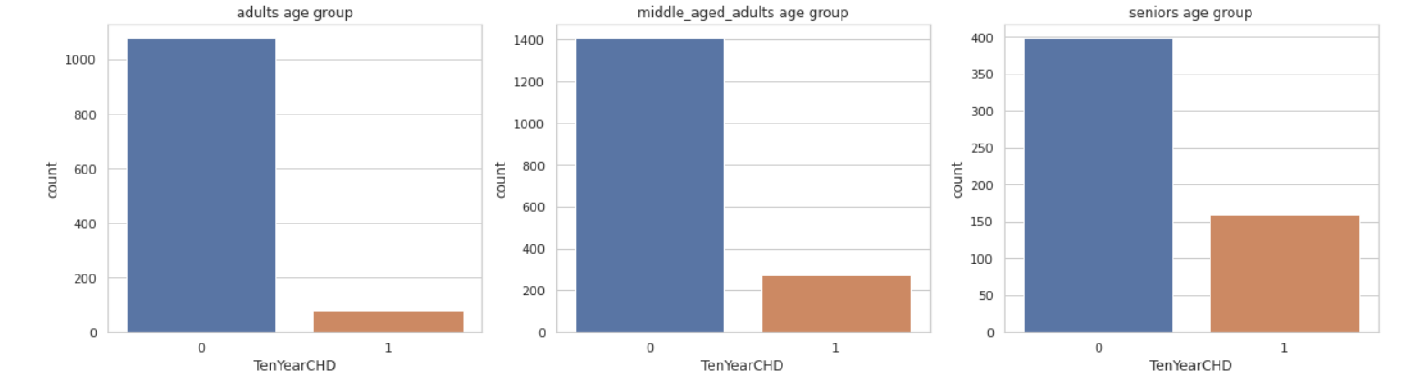
Analyzing CHD risk for different age groups

Slide 15
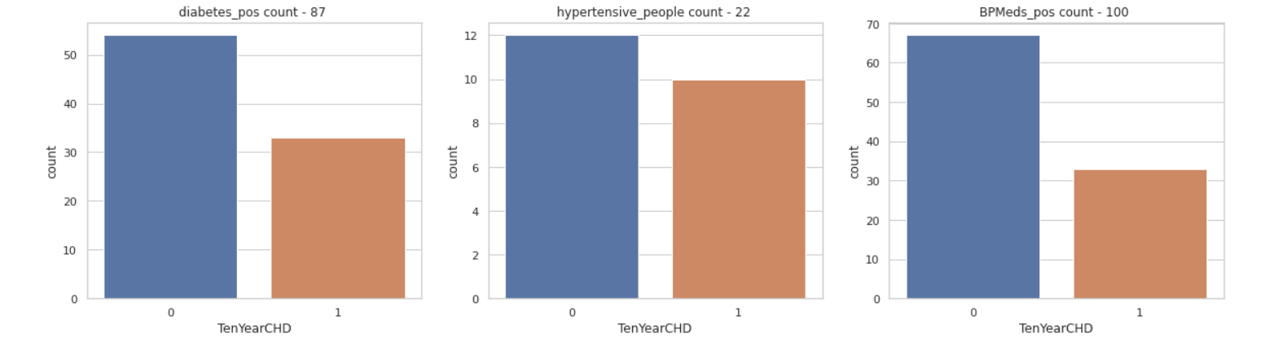
Analyzing CHD risk for different disease conditions

Slide 16
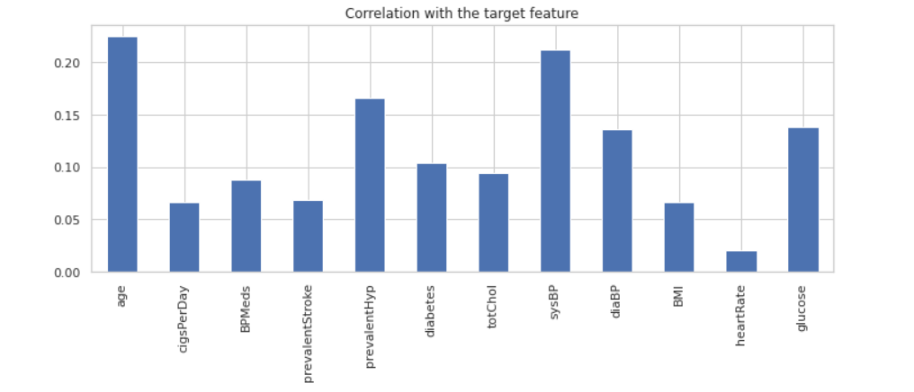
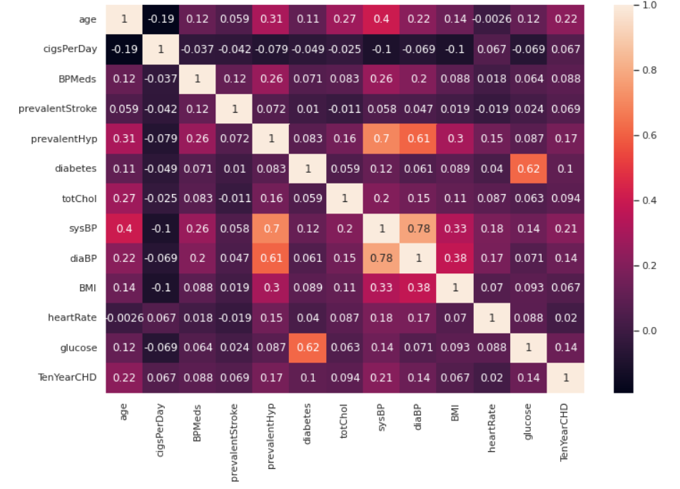
MULTIVARIATE ANALYSIS
Correlation table

Slide 17
EDA insights:
The dependent variable - 10-year risk of coronary heart disease is unbalanced. Only ~15% of the patients in the study were eventually exposed to the risk of this heart disease, rest of the patients were not exposed to this disease after the end of 10 year study.
There are more female patients compared to male patients.
Almost half the patients are smokers.
100 patients under the study are undertaking blood pressure medication.
22 patients under the study have experienced a stroke.
1069 patients have hypertension.
87 patients have diabetes.
The risk of CHD is higher for older patients than younger patients.
No conclusive evidence on the risk of CHD with other continuous variables
More percentage of men are at high risk for getting cardiovascular disease.

Slide 18
EDA insights:
Higher percentage of people who are smoking are at high risk.
For people at high risk of cardiovascular disease there is 50% chance that they had prevalent hypertension.
37.93% of people with diabetes have CHD
45.45% of people with Hypertension have CHD
33.33% of people who take BP medication have CHD
28.54% of Senior age people(> 59 years) have CHD
16.27% of middle age people(>45 & <60 years) have CHD
6.82% of Adults(<45 years) have CHD
Senior age groups (> 59 years) are relatively at much higher risk for cardiovascular disease and adults (>= 32 but < 45 years) are relatively at lowest risk.
'sysBP' and 'diaBP' are highly correlated with 0.78 correlation.
'glucose' and 'diabetes' are also slighly correlated with 0.62 correlation
'sysBP' and 'prevalentHyp' are 0.7 correlated.
'diaBP' and 'prevalentHyp' are also 0.61 correlated.

Slide 19
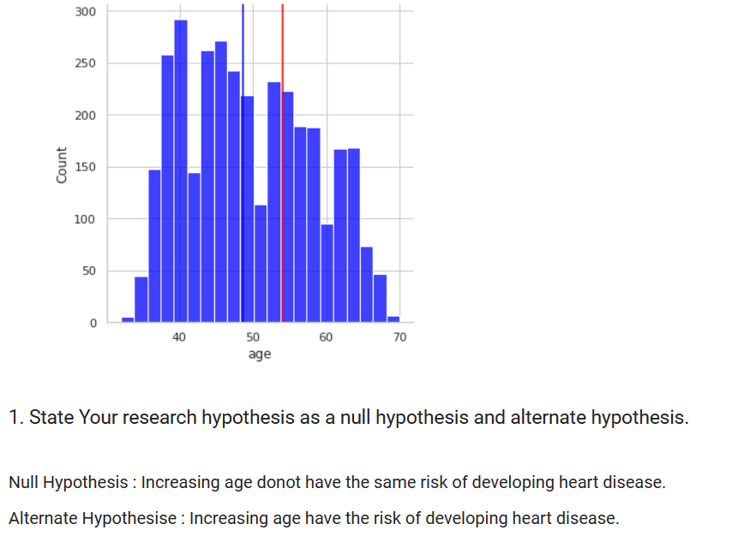
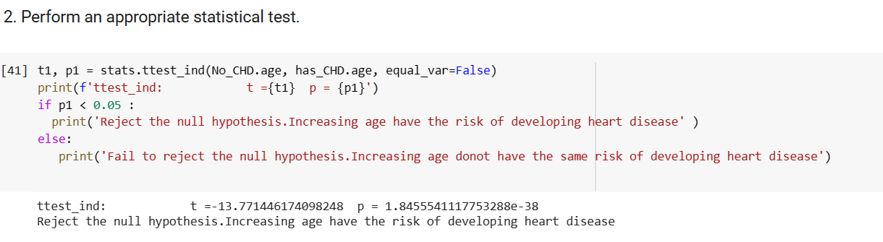
Hypothesis Testing

Slide 20
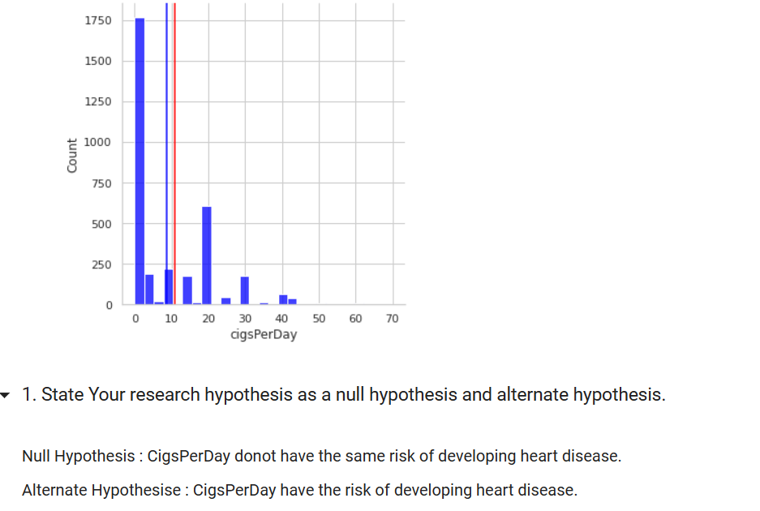
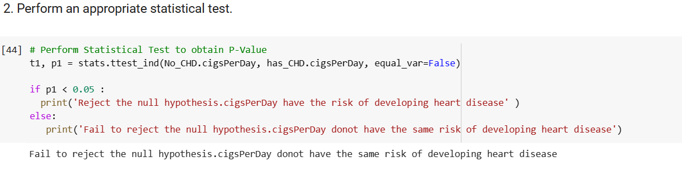
Hypothesis Testing

Slide 21
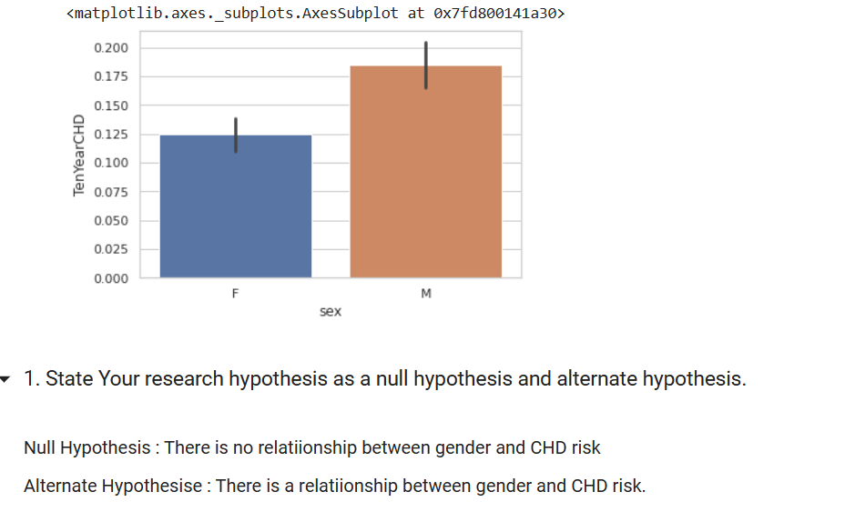
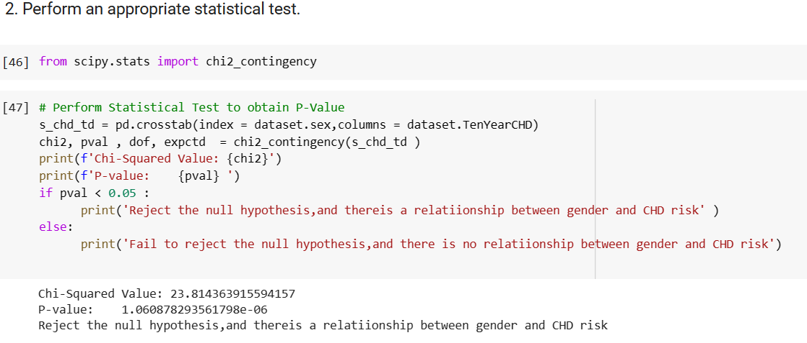
Hypothesis Testing

Slide 22
FEATURE ENGINEERING
Data Wrangling: We have removed ID and education column from our dataset
Handling Missing Values: median imputation in which the missing values are replaced with the median value of the entire feature column. When the data is skewed, it is good to consider using the median value for replacing the missing values.
Handling Outliers: we have IQR method for identifying outliers to set up a “fence” outside of Q1 and Q3. Any values that fall outside of this fence are considered outliers. To build this fence we take 1.5 times the IQR and then subtract this value from Q1 and add this value to Q3. Then we Replaced Outliers with median value. Since the IQR is simply the range of the middle 50% of data values, it's not affected by extreme outliers.
Categorical Encoding: we have simply converted sting to integer by using apply function and if & else statement

Slide 23
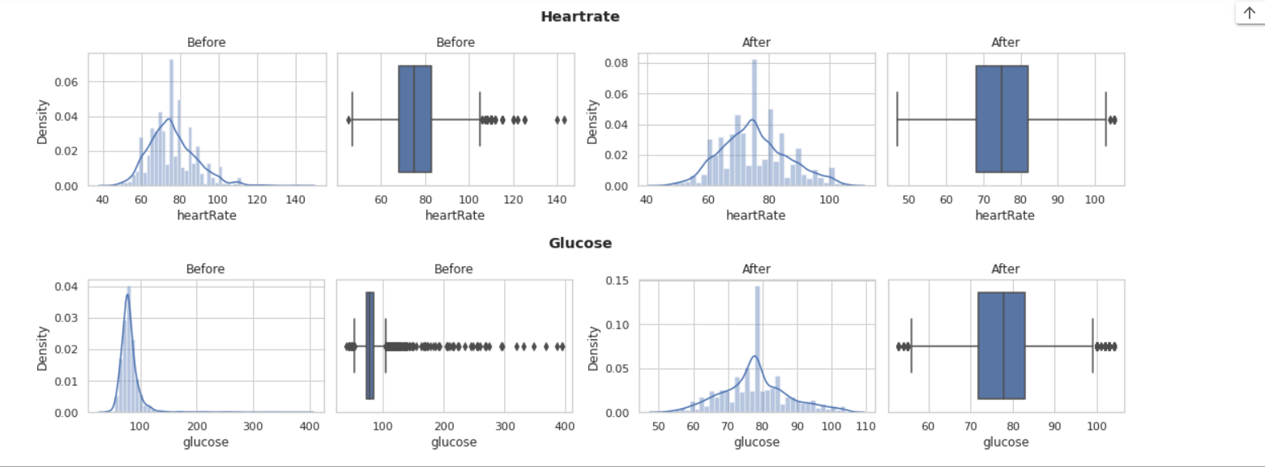
HANDLING OUTLIERS

Slide 24
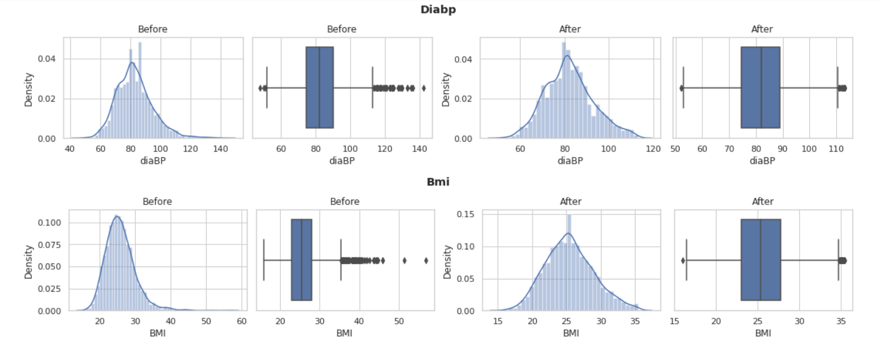
HANDLING OUTLIERS

Slide 25
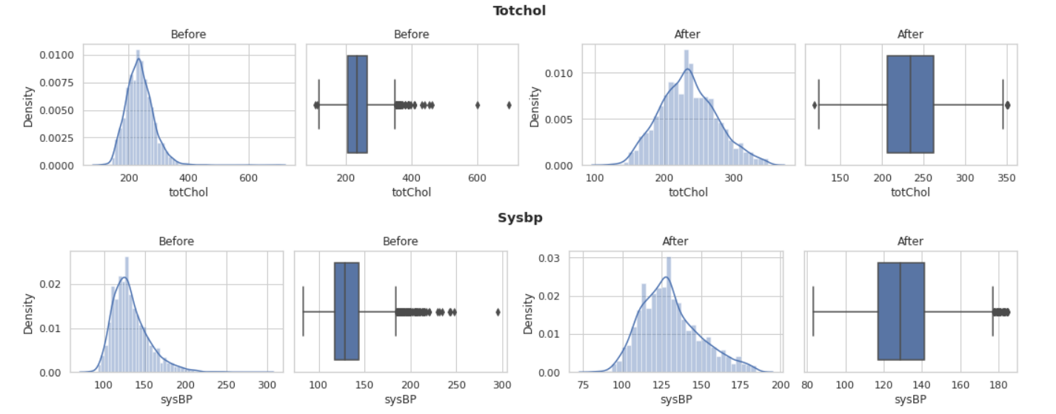
HANDLING OUTLIERS

Slide 26
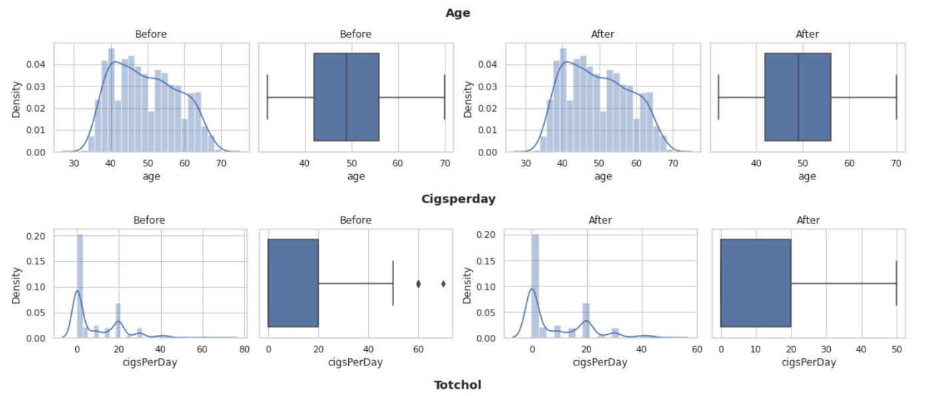
HANDLING OUTLIERS

Slide 27
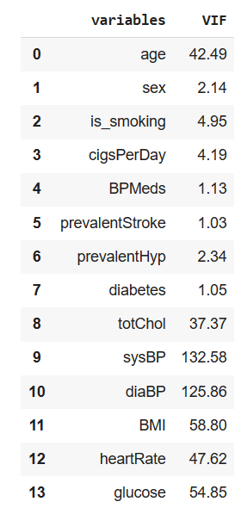
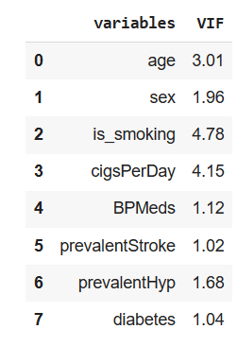
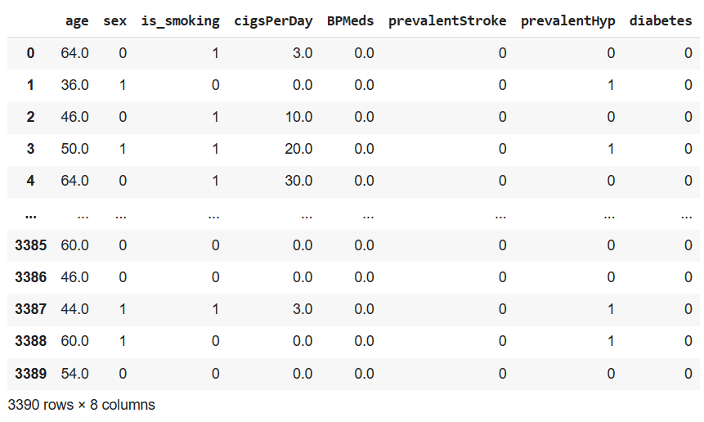
FEATURE SELECTION
A variance inflation factor (VIF) is a measure of the amount of multicollinearity in regression analysis. Multicollinearity exists when there is a correlation between multiple independent variables in a multiple regression model. This can adversely affect the regression results. Thus, the variance inflation factor can estimate how much the variance of a regression coefficient is inflated due to multicollinearity.

Slide 28
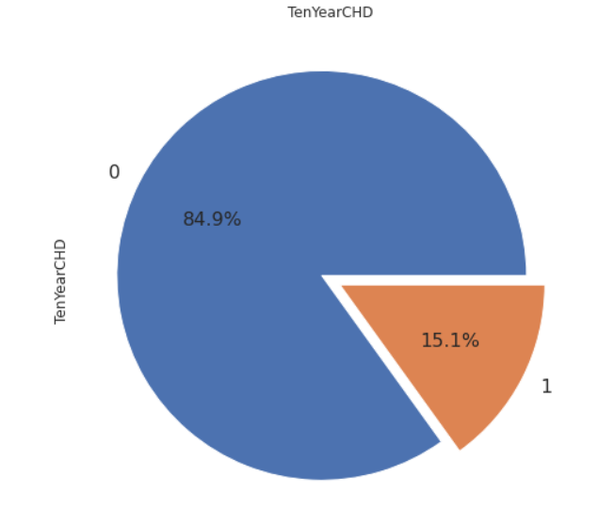
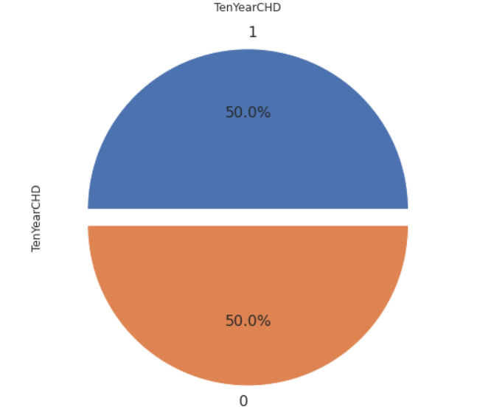
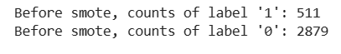
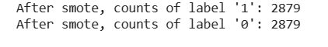
SMOTE
SMOTE (synthetic minority oversampling technique) is one of the most commonly used oversampling methods to solve the imbalance problem. It aims to balance class distribution by randomly increasing minority class examples by replicating them.

Slide 29
DATA SCALING
We have used Standardization scaler. Standardization scales each input variable separately by subtracting the mean (called centering) and dividing by the standard deviation to shift the distribution to have a mean of zero and a standard deviation of one.

Slide 30
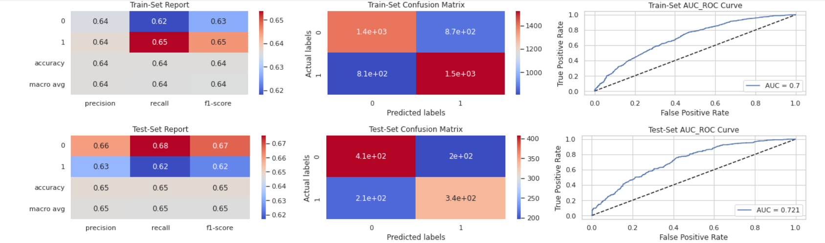

Logistic regression classifier

Slide 31

Logistic regression classifier with Hyperparameter tuning

Slide 32

Naive Bayes Classifier

Slide 33

Support Vector Classifier

Slide 34

Support Vector Classifier with hyperparameter tuning

Slide 35


Random Forest Classifier

Slide 36

Random Forest Classifier with hyperparameter tuning

Slide 37


XGBoost Classifier

Slide 38

XGBoost Classifier with hyperparameter tuning

Slide 39

KNN Classifier

Slide 40

KNN Classifier with hyperparameter tuning

Slide 41
Conclusion
If we want to completely avoid any situations where the patient has heart disease, a high recall is desired. Whereas if we want to avoid treating a patient with no heart diseases a high precision is desired.
Assuming that in our case the patients who were incorrectly classified as suffering from heart disease are equally important since they could be indicative of some other ailment, so we want a balance between precision and recall and a high f1 score is desired.
Since we have added synthetic data points to handle the huge class imbalance in training set, the data distribution in train and test are different so the high performance of models in the train set is due to the train-test data distribution mismatch and not due to overfitting.
Best performance of Models on test data based on evaluation metrics for class 1:
(i) Recall -Xgboost classifier with hyperparameter tuning
(ii) Precision -Xgboost classifier with hyperparameter tuning
(iii) F1 Score -Xgboost classifier with hyperparameter tuning
(iv) Accuracy- Xgboost classifier with hyperparameter tuning
Overally ,we found xgboost as our best fit model with hyperparameter tuning.

